Slide 1

HUMANITIES COMPUTING I RELIGIONSVIDENSKABEN
Og i religionsundervisningen
22/3/18
KATRINE FRØKJÆR BAUNVIG, Lektor, ph.d. & cand.mag
RELIGIONSSTUDER / DATAKUBEN

Slide 2
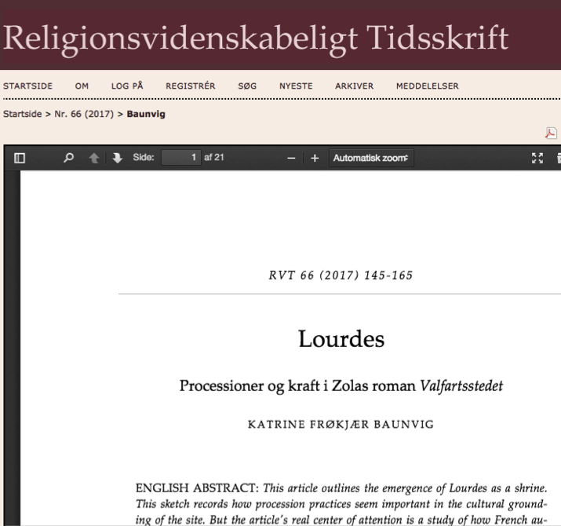
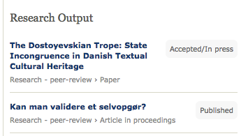

Slide 3
I D A G
K O N T E K S T
F O R S K N I N G
R E S S O U R C E R
Hvorfor interessere sig for datadrevet forskning?
Hvad laver datadrevne humanister?
Hvor kan man gå hen, hvis man har lyst til at bruge det i sin undervisning?

Slide 4
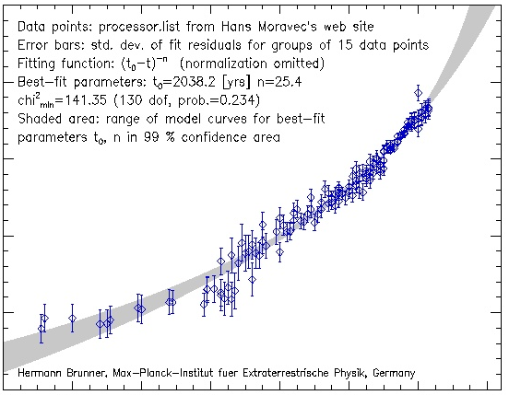

K O N T E K S T
Superbrugere

Slide 5

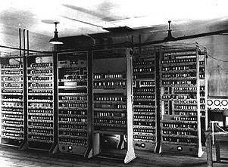

K O N T E K S T
REGNEKRAFT

Slide 6
K O N T E K S T
less more is more
DATA
mængde

Slide 7

K O N T E K S T
Regeringsstrategier
EU-strategier
Institutionsstrategier
Kundskaber og kompetencer
… Singularity University
Konkurrence fra andre fagfelter
Vigtigt felt for humanistiske akademikere
Naturarvsforvaltning
Undervisning
Forskning

Slide 8

Kvalificerede, skeptiske efterrefleksive brugere

Slide 9
K O N T E K S T
less more is more
DATA
mængde
Notes:
For nok er der masser af data… men hvilken…?

Slide 10
K O N T E K S T
OCR-KVALITET
big’n’dirty data

Slide 11
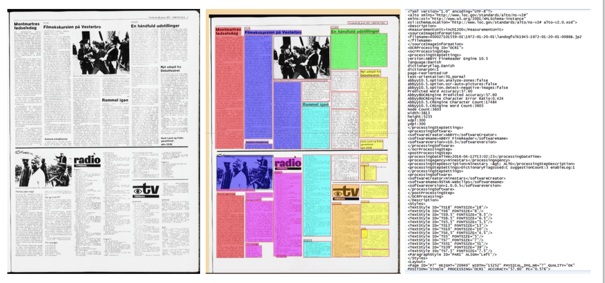
K O N T E K S T

Slide 12
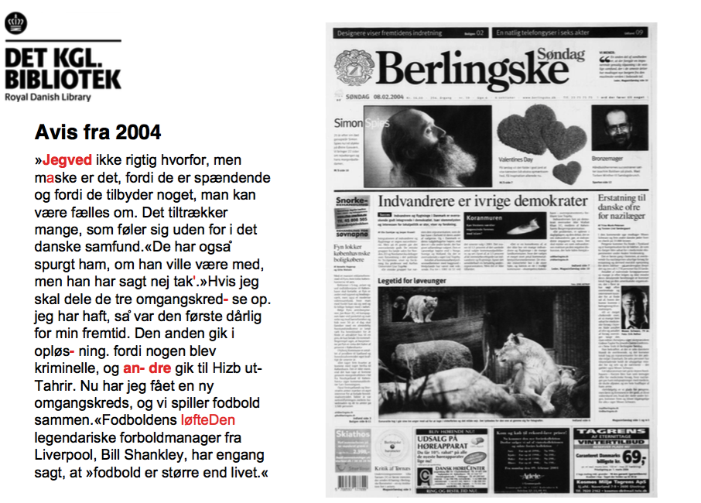
K O N T E K S T
F
E
J
L

Slide 13
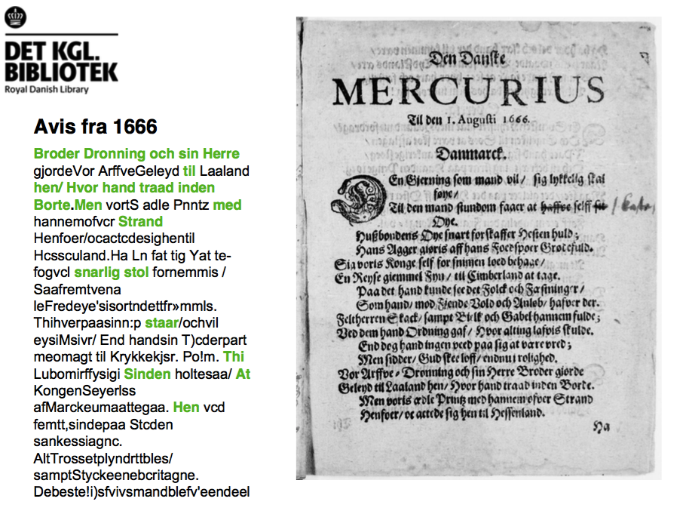
K O N T E K S T
R
I
G
T
I
G
T

Slide 14
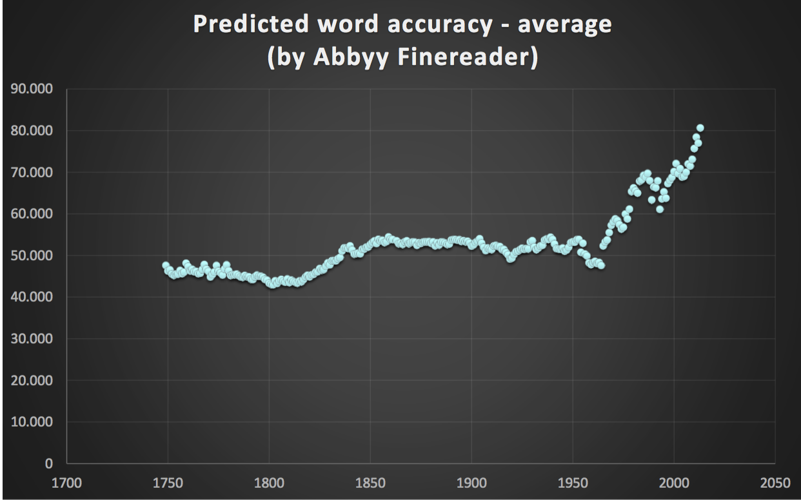
K O N T E K S T

Slide 15
K O N T E K S T
FORLAG OG MEDIEHUSE

Slide 16
K O N T E K S T
La bonne distance
Royalties ---- OCR-kvalitet
1800-tallet
Romaner
Aviser
Forfatterskaber
DATA

Slide 17
F O R S K N I N G
DIGITAL HUMANIORA /
HUMANITIES COMPUTING
Handler om digitalisering
  henvender sig til ’digital-humanistisk miljø’
Bruger digitale redskaber
  Henvender sig til det traditionelle fagmiljø
> <

Slide 18
F O R S K N I N G
DIGITAL HUMANIORA /
HUMANITIES COMPUTING
Handler om digitalisering
  henvender sig til ’digital-humanistisk miljø’
Bruger digitale redskaber
  Henvender sig til det traditionelle fagmiljø
> <

Slide 19
F O R S K N I N G
DATAKUBEN / SDU
Redskabsekspertise
Domæneekspertise
MRW
KLN
KFB
Æ N D R E T A R B E J D S G A N G

Slide 20
F R A M I N F O R S K N I N G
1
GRUNDTVIG – kan man måle et selvopgør? Kan man måle sindssygdom med txtmining?
!
Bewildering Rewilding – Kan man sortere i moderne autenticitetskultur?
HOW THE BIBLE MOVES Kan man måle sekularisering i bibeloversættelser?
2
Udråbstegn i litteratur i romantikken
3
4

Slide 21
1

Slide 22
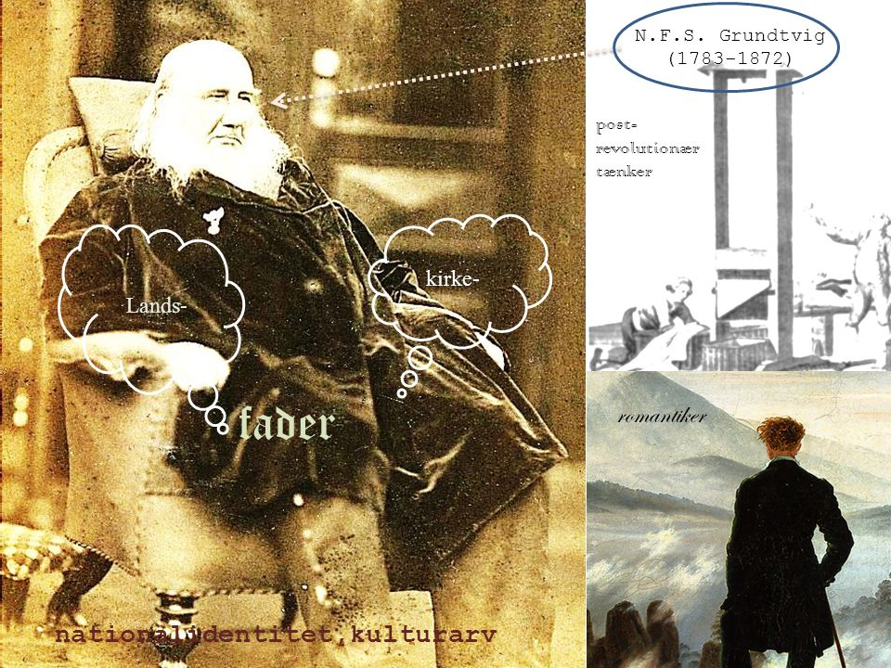

Slide 23
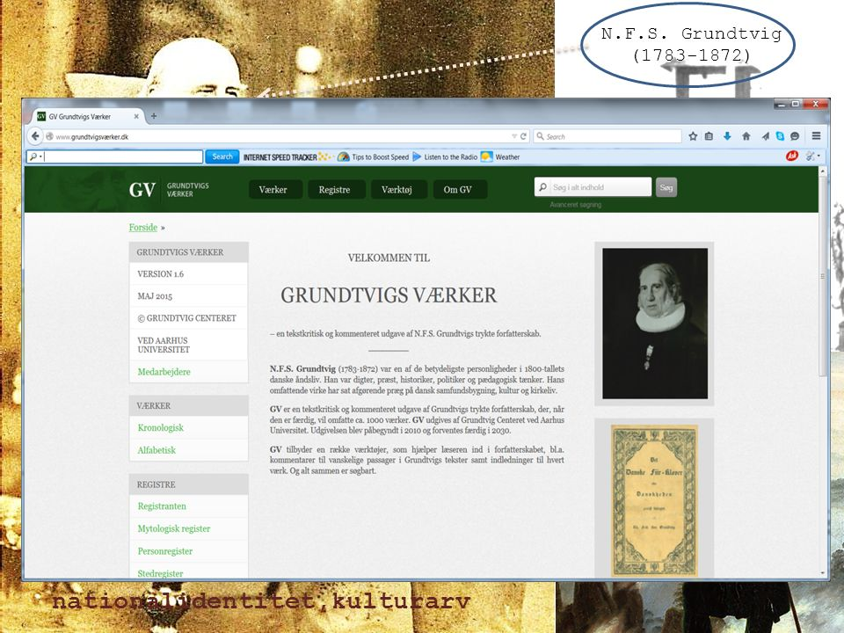

Slide 24
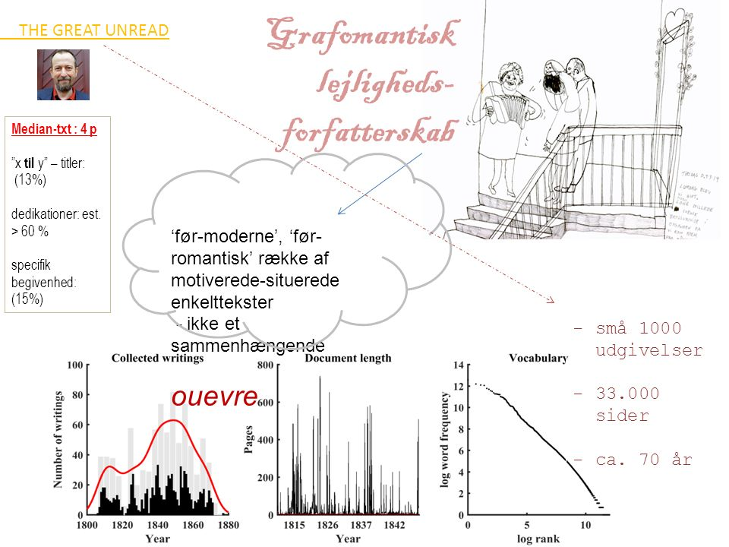

Slide 25
Type-token-ratio:
Var Grundtvig sindssyg? jahhh
Lavede han et selvopgør? jeps
Var han kreativ?
tjahh

Slide 26
Entropi

Slide 27
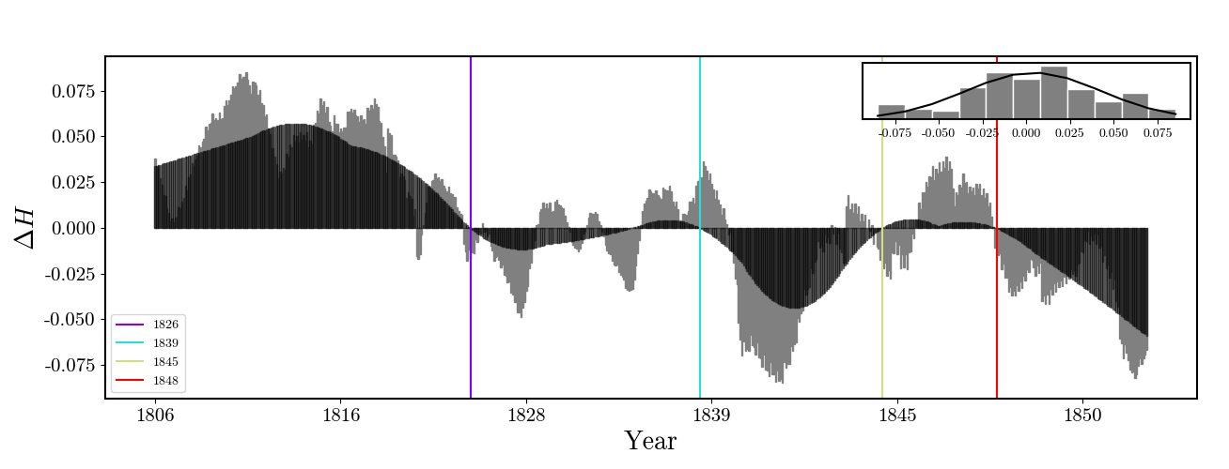
Fraktalanalyse

Slide 28
2

Slide 29
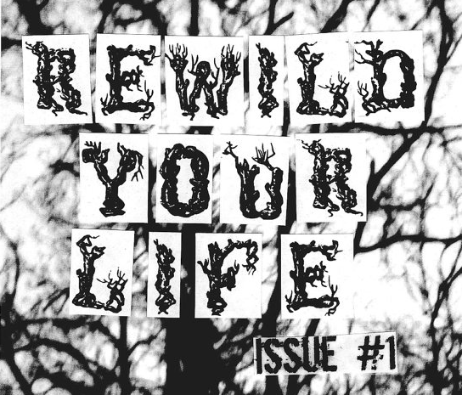
Bewildering
ing
Fjernlæsninger af ruiner og ensomme vandrere i romantikken
Notes:
I am stepping a bit out of my comfort zone. So: Beare with me…
Motivated by current rewilding discourse in mainstream popular culture – This discourse can to some extent be viewed as a reaction to phenomenas clustered under the category of modernity

Slide 30
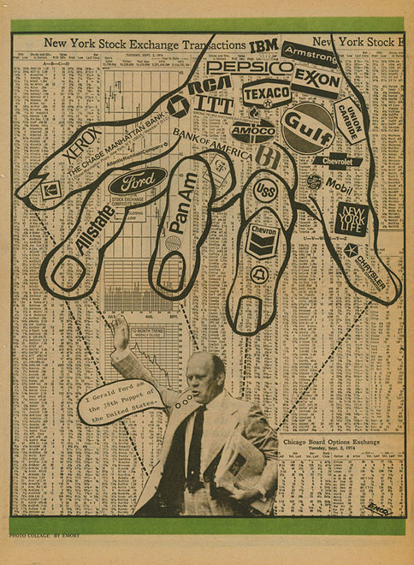
Stress
Perpleks og accelerende modernitet
Consumerism
Alienation
Karl Marx
+
+
Max Weber
Émile Durkheim
James Joyce
Georg Simmel
+
+
+
Franz Kafka
+
+
Paul Veyne
Eric Hobsbawm
+
Kenneth Goldsmith
+
+
+
Hartmut Rosa
+
Fransk revolution
+
+
Notes:
On the one hand we have scholarly and literary-intellectual reflections pertainting to ’THE MODERN CONDITION’
NOICE – SPEED – FRAGMENTATION
Hartmut Rosa deals the concept of acceleration – but this is not a new discovery. For instance, British historian Eric Hobsbawm (1917-2012) for many years used acceleration as a keyword in his descriptions of the long 19th century. But Rosa introduces an analytical sensitivity to the fast and abrupt quality of modern life missing from earlier theoretical compendiums. A quality that calls for deceleration – for slow-food, slow-TV and (fantasies of) life in the woods or on the farm – I add.
Life in modernity, however, is not only fast it is also furiously fragmented. This at least was what Max Weber (1864-1920) pronounced in is his sociological analysis of rationalization processes in works published in the late 1910’s (nn, nn). But he did not monopolize this insight. Concomitant with Weber’s thoughts on different and to a certain degree competing spheres of rationality, Irish writer James Joyce (1882-1941) published Ulysses in 1922. I do not claim any direct influence. What I am aiming at has to do with concurrency and Zeitgeist: From completely different angles Weber and Joyce tried to document the wilderness of knowledge domains rivalling over the attention of the individual. Weber interprets his own time guided by the words iron cage and rationalization; Joyce’s notoriously conflicting and confusing story about a single day in the life of Leopold Bloom binds in leather the discursive cacophony of modern existence. Weber and Joyce thus drew parallel contours around a condition, which intellectual and artistic reflections have matured throughout the 20th century. French ancient historian Paul Veyne’s (1930-) ideas of ‘mental balkanization’ could in this perspective be perceived as Weber’s psychologically informed heir (Veyne 1988,); likewise, American poet-scholar Kenneth Goldsmith’s (1961-) 1997 piece Soliloque – a transcription of records of every single thing uttered by the author for an entire week – picks up the chaotic, disruptive feelings in Ulysses. Goldsmith and Veyne, Joyce and Weber are, however, just a few examples of complex and eloquent dealings with the perplexing modern condition. But eloquence is not a requirement in this discourse: the speed and turmoil of our time is on the contrary regretted in many spheres, in diverse media and at different levels of articulation. And a significant part of the regret is articulated in the visual, written or verbal language of rewilding.

Slide 31

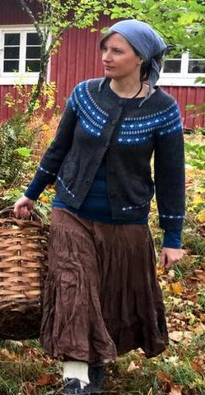
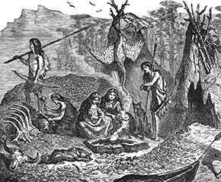
[rewild]
Daniel Vitalis
Andrea Hejlskov
Your -self
Your family
TRENDS
Paleo
Natural
Vital
Free
Diet
Emancipation
Pagan
Peace
Anarchism
Authentic
Harmony
Barefoot
Self-sufficient
Stone Age Ideal
Notes:
On the other we see all theese ’rewilding’ activities articulated and percieved as precisely reactions to the noise and the speed of modernity
So this is me avoiding a definition… But it is sort of intentionally…. To do with my method and my data – I will get back to that.
Daniel Vitalis and Andrea Hejlskov are perfect icon-like forerunners within this movement. They practise as they preach, so to speak. But the trend does not only flourish amongst theese extreme cases: Rewilding yourself andrewilding your children and family constitutes an entire therapeutic and anti-consumerist media-marked.
Andrea Hejlskov (1975-). In 2010 she and her family left their normal, urban life in Copenhagen for a life in the woods of Värmland in southern Sweden. She thoroughly documents this undertaking on the blog https://andreahejlskov.com/ with posts such as “Chop wood/fetch water”, “Resilience” and “Solidaric prepper”. She frames the site as (and I quote): ”an environmental, bush-crafty, prepper-ish blog about topics ranging from complete existential meaninglessness to the true authentically joy of living in the wild forest, close to the land.” Andrea Hejlskov and her blog have received a lot of public attention in Denmark – provoking many feature articles in newspapers.

Slide 32



Gone “are the streets and the noise, the bustle and the mannered; the merchants and the attorneys, the journalists and the artists. Gone are the industry and the technology. In this absence the human being is natural” (2006, 29)
Notes:
But the trend continues in popular northern European literature…
Norwegian author Erlend Loe (1969-) has written a melancholy-satirical novel on existential complexities in the life of the middle-aged and middle-class man, Doppler (2004). Doppler, frustrated with himself, the hectic nature of daily life and sociality as such, leaves behind his significant others – his wife and children – and as a modern day Henry David Thoreau (1817-1862) he goes into the wild. Drawing on Roland Barthes (1915-1980), Loe’s lean narrative can be said to have only few cardinal functions (Barthes 1983, 265-266). That is to say, nothing much happens: Camping in the Norwegian woods, Doppler orphans and adopts a moose calf – and finds inner peace. This peace has adapted well to the Scandinavian book marked. In any case Loe’s novel is widely circulated. Peace and quiet thus suddenly replaces modern, urban audial phenomena - such as the traffic noise and physical phenomenon hidden within the name ’Doppler’.
Another perhaps a bit more high-brow example:
Norwegian tramp-author Tomas Espedal’s (1961-) essay Gå. Eller kunsten å leve et vilt og poetisk liv (Tramp. Or the Art of Living a Wild and Poetic Life) (2006) plots out another way of leaving the humdrum of the everyday. A life on the road: Gone (and I quote): “are the streets and the noise, the bustle and the mannered; the merchants and the attorneys, the journalists and the artists. Gone are the industry and the technology. In this absence the human being is natural” (2006, 29). The book seems to resonate a general restlessness within the book buying segments of the Scandinavian population: Espedal’s thoughts on walking from Norway to Turkey effortlessly packed with quotes (Rousseau, Voltaire, Kierkegaard, Kafka, Rimbaud, D.H. Lawrence, Shakespeare, Stephen Graham, Hazlitt, Dante, Duras and many, many more) has been translated into several languages, run in several editions and received endless emphatically enthusiastic reviews.

Slide 33
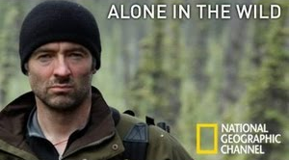
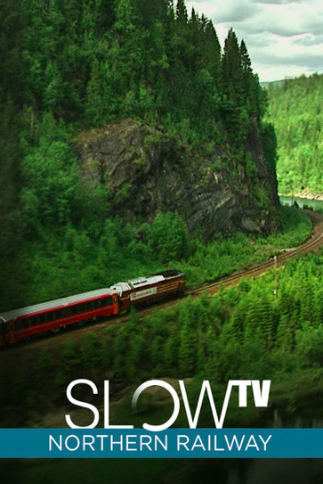
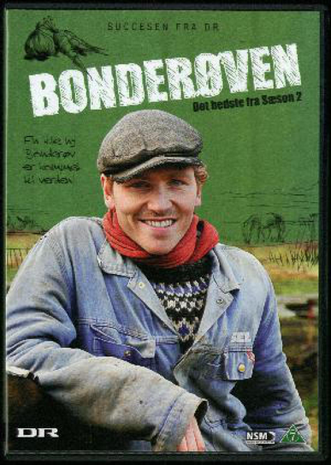

VILDMARK// RUSTIK Pop
Hunter-Gatherer
1
Primitivism, Extreme, Survival
2
Agri-
culture, Simple-Living, Sustain-ability
BONDEMAND
Notes:
But the rewilding trend is perhaps most visible as thematically interrelated documentaries. To me there seems to be two major subgenres: 1) Wilderness-survival-pop and 2) Rustic-agricultural-simple-living-pop
The representation of wild nature / rustic agriculture as a counter-cultural sceneries seems to be an implicit and aesthetic strategy weaving together a wide range of television productions such as the English, Channel 4 survival-documentary ‘Alone in the Wild’ (2009-), the Norwegian slow-television broadcast in real time of a coastline train journey from Bergen to Oslo (2012), and the Danish agricultural entrepreneur Frank Erichsen’s ‘Bonderøven’-show (2008-) known in English as the ‘Danish Dirt Farmer’.
These are of course just a few instances of a general trend situating a critique of modern consumerism and social complexity within a specific lifestyle proclaimed by its followers to be ‘simple’ and ‘authentic’.
In lack of sociological surveys, we have to contend ourselves with (informed) assumptions: The vast majority attracted to ‘simple-living-in-the-wild’-products seems to satisfy their needs for counter-cultural protests through media consumption. Instead of giving up their lives anchored in urban modernity, they buy and read the books of those who have taken to the woods; stream and watch the programmes on self-sufficient lifestyles.
And there seems to be a subgroup pertaining to Hunter-Gatherer activities and one focussing on farmer-activities….

Slide 34

romantic mentality//word-cloud
Notes:
If one scrape relevant rewilding-websites for words a rather dense and congruent word-cloud appears:
This cloud reveals/indicate that what we are dealing with is in fact a left over from the romantic period…
That at least is what I want to propose: That what we are dealing with with in current rewilding discourse is a continuation of a mentality condensed within the latter part of the 18th century.
Furthermore I want to suggest, that :
the two main sub-genres (the survival vs. simple-living – the hunter vs. the farmer) to some extend map onto leid-motifs in the cultural distribution around the year 1800.

Slide 35
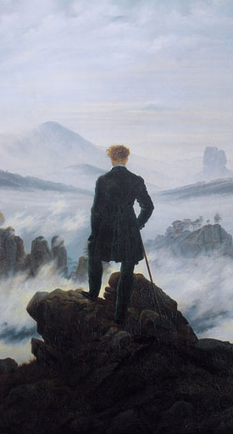
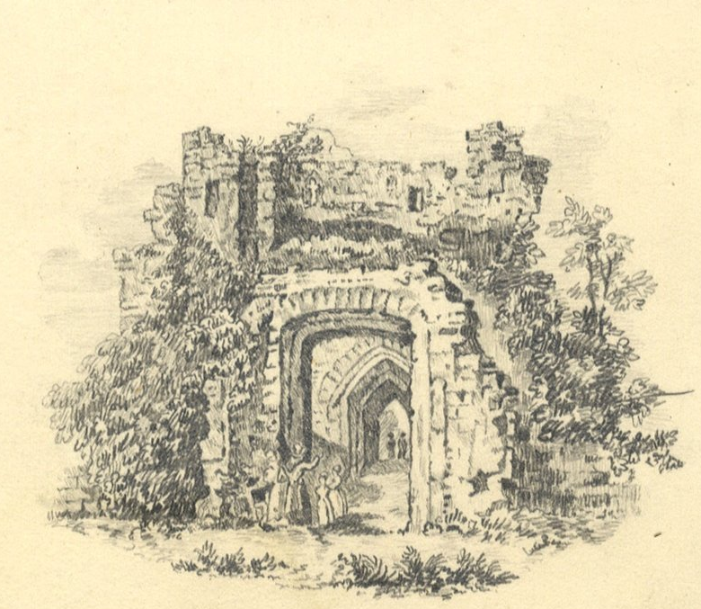
Keywords//Troper//
Motiver
Romantic Rewilding:
[SOLITARY WALKER]
[RUIN]
THE GREAT ESCAPE
THE GREAT DECAY
Notes:
And I have – through intuition and software - teased out two main tropes or motifs as the ones driving the ‘rewilding’ discourse of the years around 1800.
And here I should probably return to the definition I to a certain extend skipped earlier: By rewilding I understand ‘an activity valorising COUNTER-CULTURAL experiences: Such experiences will typically be: critical, meta-cognitive procedures undertaken away from an everyday context and from a city life scenery.
The term rewilding is- as we know - imported from biological vocabulary ideologically focussing on the restoration, preservation and conservation of wildlife and wilderness areas. As Jay Johnston shows in her paper, this language is synchronised with and seems to map onto the existential-therapeutic endeavours of individuals such as Doppler and Hejlskov who, fascinated by ‘authenticity’, are leading (or representing) technologically simple lives preferably in the wild and thus (often misanthropically) constraining their social activities. Accordingly,
I widen the term rewilding to include physical, mental and aesthetic strategies following from a sceptical attitude towards civilization, industrialization and urban culture in general. In other words: strategies that react to modern conditions. Moreover, following mainstream modernization theories I take these conditions to dominate ever-increasing parts of the populations in Europe, the Americas and Australia from the latter half of the 18th century and onwards. Conveniently fitting to this periodization is the fact that what one could perhaps think of as rewilding motifs grows significantly in poetry, visual arts, literary fiction and philosophic reflection from ca. 1760-1850: the romantic era. The attention given in different genres to self-revelatory insights experienced away from city life and normal society is consequently striking within this period. For instance we see forerunners of Espedal in the solitary walkers of Caspar David Friedrich’s (1774-1840) iconic Der Wanderer über dem Nebelmeer (Wanderer above the Sea of Fog) painted in 1818 and

Slide 36
3

Slide 37

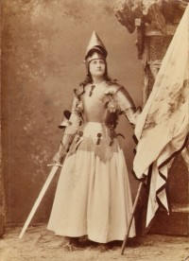

Shabby Chic Containers of Total Devotion
Katrine Frøkjær Baunvig
Associate professor
Studies of religions
baunvig@sdu.dk
!!!!!!!!!
Romanticists on Narrative Search for Peak Experience
Friedrich Schiller’s Die Jungfrau von Orléans
Notes:
Amanda Lindner as Johanna in Schillers "Die Jungfrau von Orléans” (1869)
What has this to do with religion?
Many of the text are on emotions deemed religious, radical, extremist and the like…
Some of them even use the gallery of supernatural agents harvesten in old mythologies…
And together they tend to negotiate the status of feelings once legitimate because of their religious domain – now transferred to a personal

Slide 38
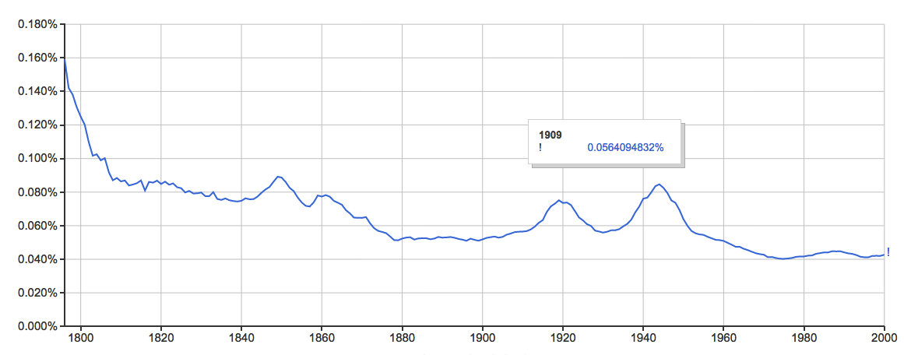
STRIKING STYLISTIC INDICATIONS OF EMOTIONAL INTENSITY
!
! !!
1800
1848
1917
1944
Distribution of exclamation marks, German

Slide 39
4

Slide 40
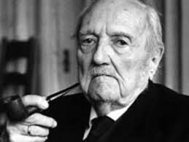
Entmythologisierung
Hvordan bevæger bibelen sig?
Rudolf Bultmann

Slide 41
KORPUS
  ALLE engelske bibeloversættelser
FORMANALYSE
SEMANTISK ANALYSE

Slide 42
I D A G
K O N T E K S T
F O R S K N I N G
R E S S O U R C E R
Hvorfor interessere sig for datadrevet forskning?
Hvad laver datadrevne humanister?
Hvor kan man gå hen, hvis man har lyst til at bruge det i sin undervisning?

Slide 43
ARKIVER & TOOLS
GOOGLE BOOKS (NGRAM)
Litteraturbanken (SE)
NB (NORGE)
BL (UK)
KB
SMURF

Slide 44
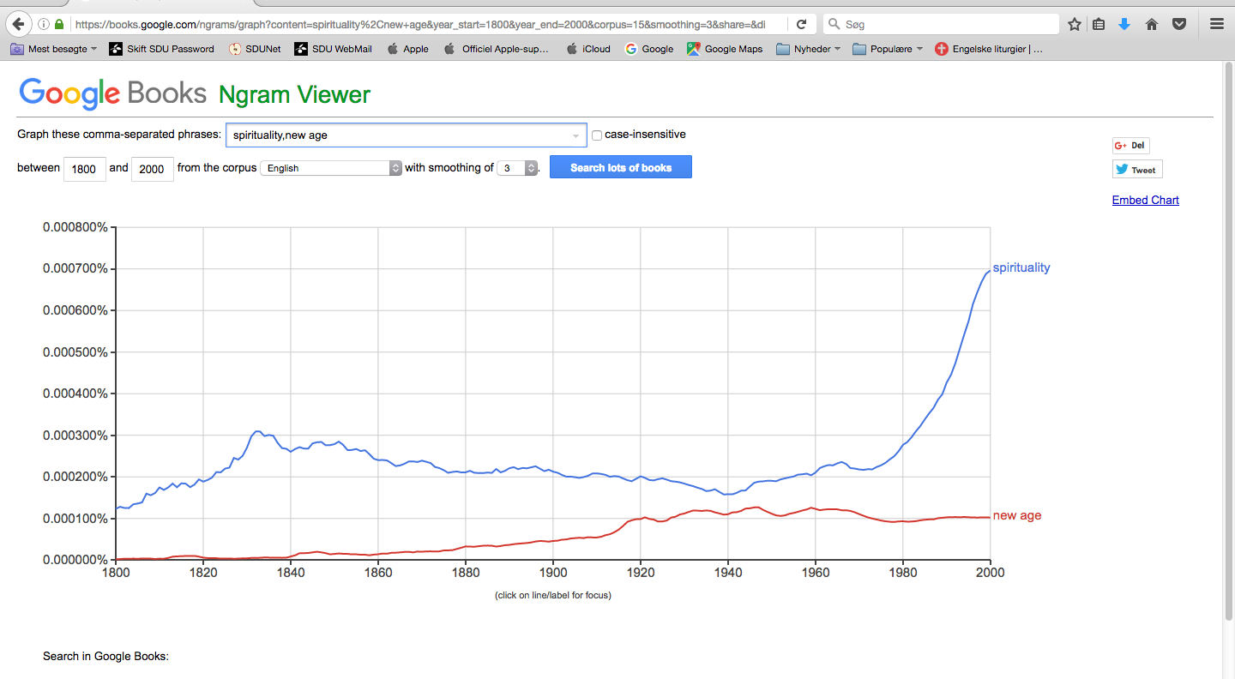
Google books ngram viewer

Slide 45
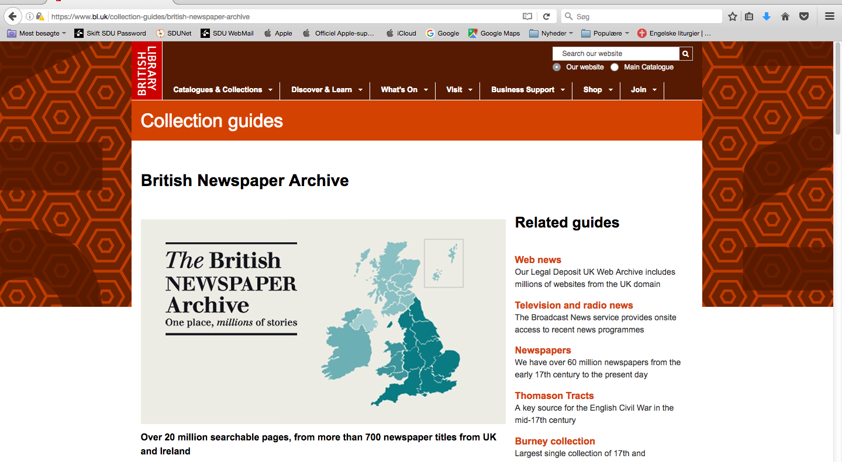
BL

Slide 46
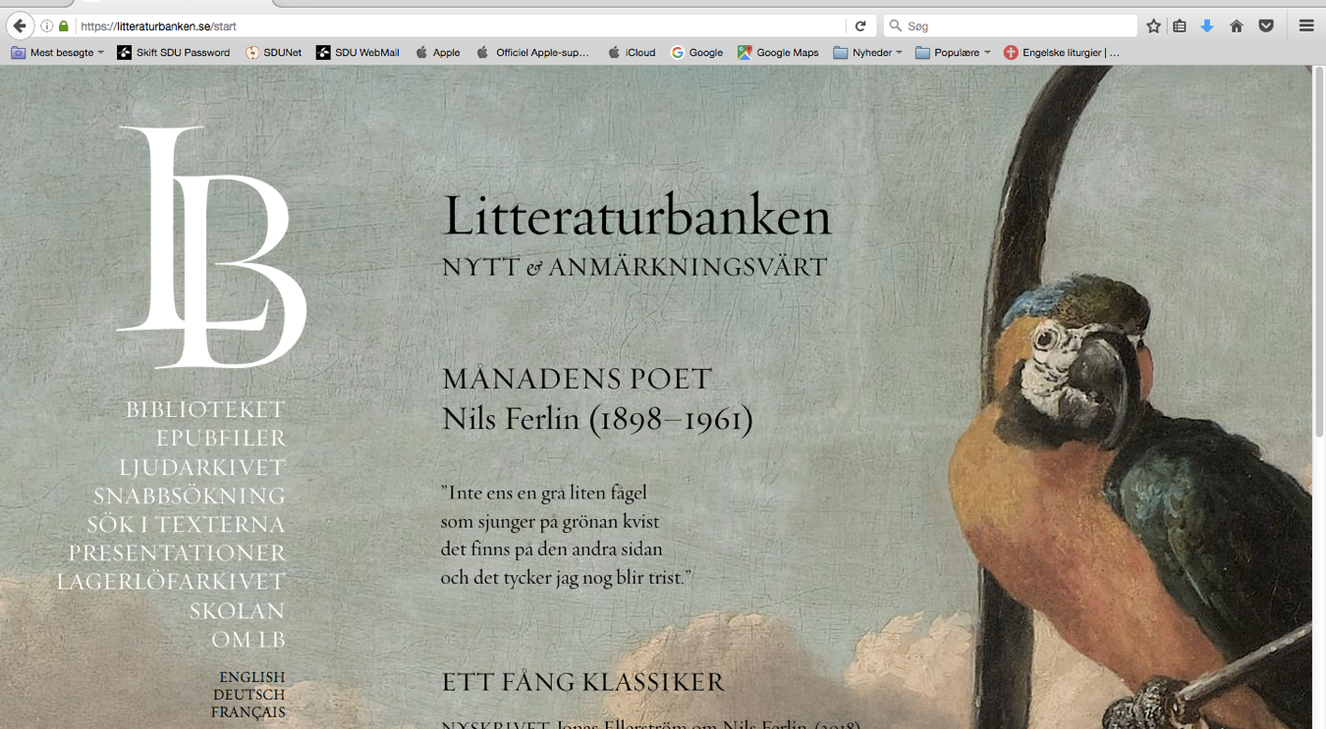
NB

Slide 47
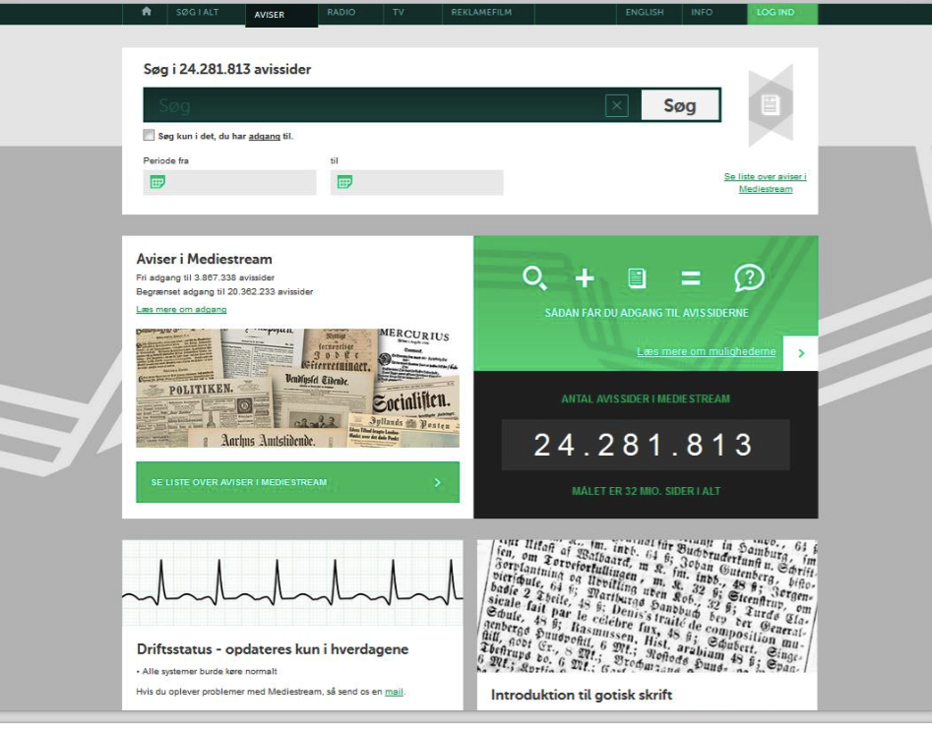
Det Kongelige Bibliotek

Slide 48
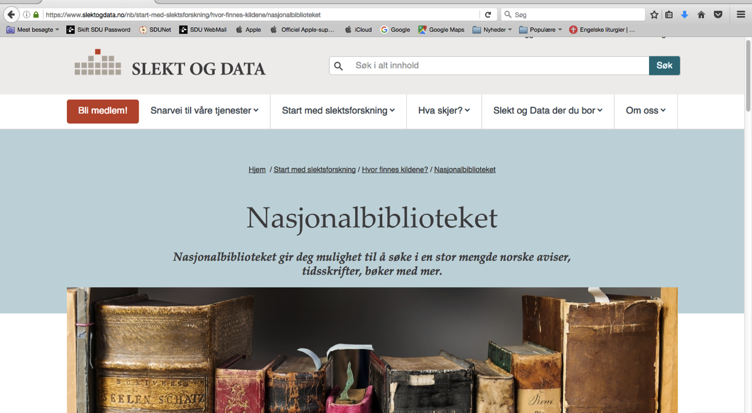
NB

Slide 49
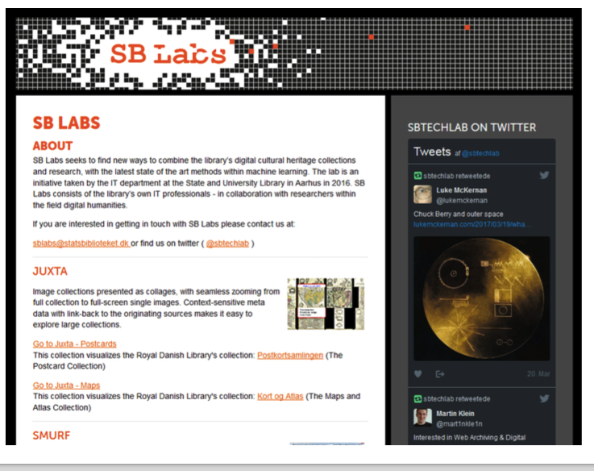
labs.statsbiblioteket.dk/

Slide 50
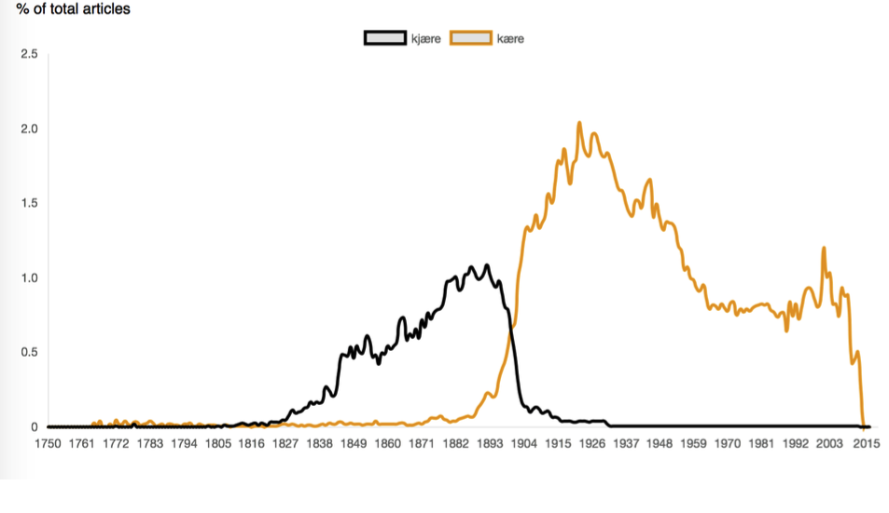
kjære vs. kære

Slide 51
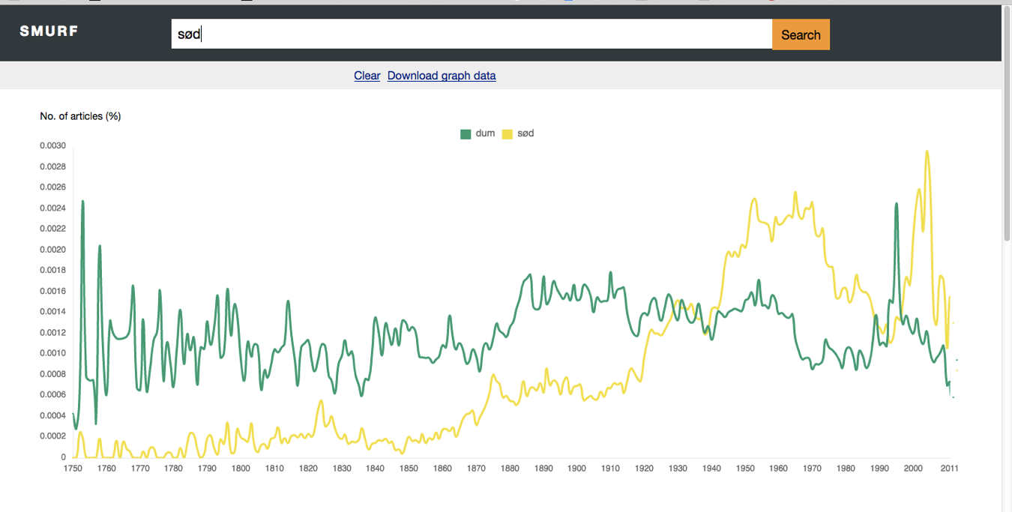
dum, sød
1750
1900
2010

Slide 52
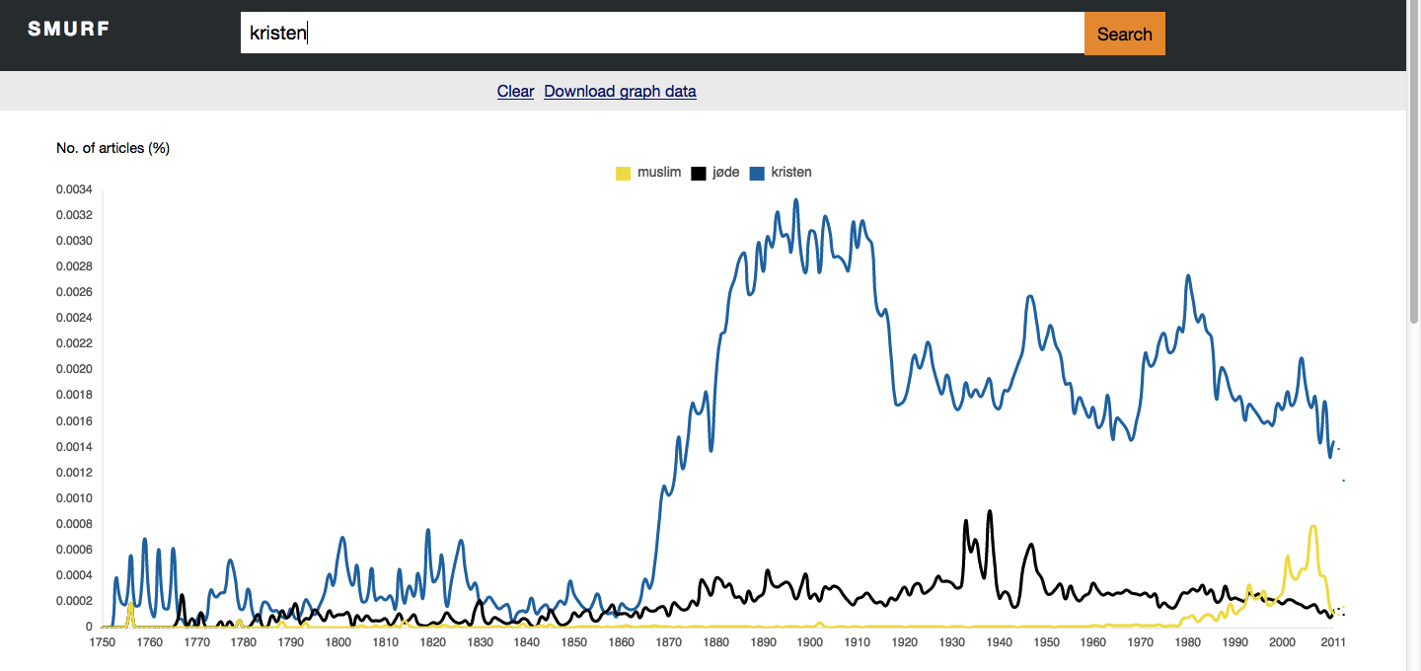
muslim, jøde, kristen
1750
1900
2010

Slide 53
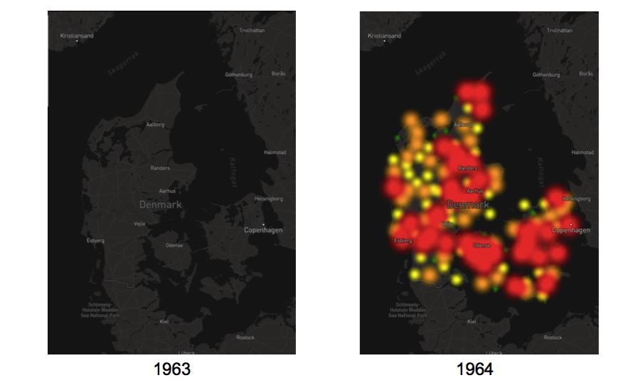
DOTS // Rolling Stones

Slide 54
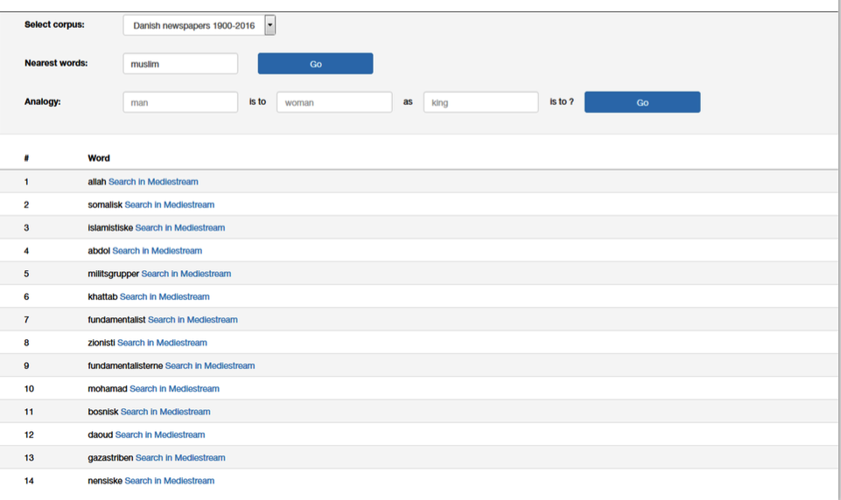
Word2Vec, ’muslim’

Slide 55
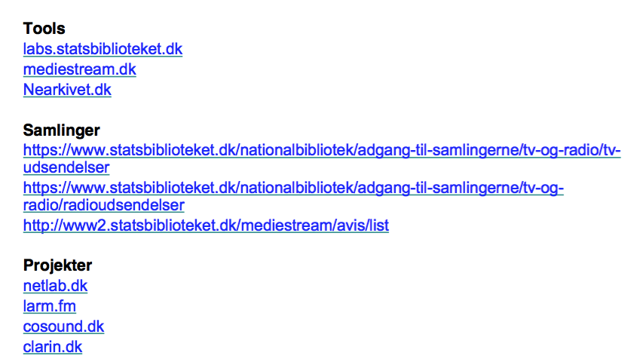
Links og referencer

Slide 56
TAK & ?

